Slide 1
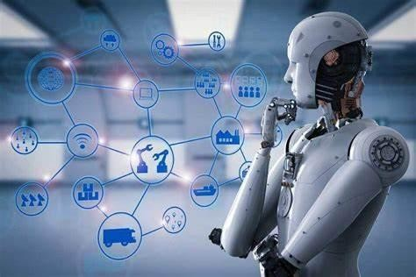
PROJECT ON AI IN CYBER SECURITY

Slide 2
INTRODUCTION:
Role of AI in modern world threat to cyber security has become a serious issue. Artificial intelligence (AI) is a branch of computer science where a machine is made capable of possessing human decision-making ability, based on certain unique algorithms and related mathematical calculations.
On the other side, Cyber Security consists of security measures to protect the virtual world from cyber attacks and threats.

Slide 3
Artificial Intelligence is capable of securing and cleaning up the cyber space by taking security measures related to accurate algorithms and mathematical calculations.
AI and machine learning are now becoming essential to information security, as these technologies are capable of swift analyzing millions of data sets and tracking down a wide variety of cyber threats from malware menaces to shady behavior that might result in a phishing attack.

Slide 4
What is Cyber Security?
When we protect the devices which are connected to the internet, this process is called Cyber security which includes protecting hardware, software, and data from the threats of cyber criminals. Individuals and organizations use this practice to protect against unauthorized access to data centers and other computerized systems. The cyber security personal need the best cyber security training to identify and stop any attacks from taking place on the system.

Slide 5
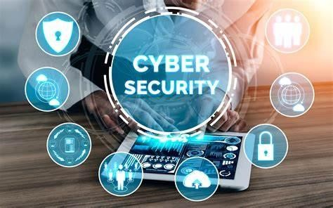
We need a strategy in cyber security that is strong enough for a good security practice against some of the malicious attacks which are crafted in order to access, tamper,delete,extortor destroy the data of an organization or individual systems and steal sensitive data.

Slide 6
Importance of Cyber Security
Now a days the number of users who are using devices and program’s have increased considerably in modern enterprise that generates a large amount of data, many of which are sensitive or confidential. Therefore here comes the importance of cyber security as in this age, data the futon these systems continues to grow. The increase in volume and more sophistication in methods that are used by cyber attackers through many attack techniques create many problems even further.

Slide 7

Scope of AI beyond traditional security measures:
Traditionally security measures depend upon antivirus software like firewall, quick heal and other tools on detecting and preventing web security threats. Looking at this scenario, timely update of software and the attitude of a person who is in charge of security would determine the level of security website or virtual platform.
AI depends upon innovative technologies like Machine Learning, Deep Learning, Natural Language Processing etc to make difficult for hackers to gain access to servers and other valuable information stored inside computers.

Slide 8
Role of AI in Cyber Security:
When we discuss artificial intelligence in cyber security it is nothing new. In fact, two years ago, in forums people would discuss how artificial intelligence and machine learning in cyber security would change the future as data is at the central part of cyber security trends. In cyber security, artificial intelligence proves to be beneficial as it improves the way security experts analyse, study, and understand cybercrime.

Slide 9
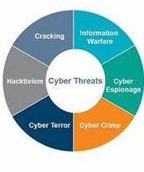
.It improves the technologies that companies use to combat cyber criminals and helps organizations keep customer data safe. But, on the other hand, artificial intelligence can be a very exhaustive resource and may not be practically applicable in every application.

Slide 10
Need for AI in Cyber security
It is impossible for a normal human to identify and block all the threats faced by a company because of the fact that every year, hackers find out a different way to launch various types of attacks that have a distinct objectives For example, in earlier times log4j was not known though it was present from the beginning, finally, it was reintroduced in December 2021. The network can suffer massive damage with the introduction of these new types of unknown threats and they can have a deep impact on the organization if you fail to detect, identify, and prevent them.

Slide 11
AI in Cyber Security: Benefits
Artificial Intelligence becomes more intelligent over Time
Artificial Intelligence helps us in identifying unknown Threats
Artificial Intelligence Can Handle a Lot of Data
Artificial Intelligence can manage vulnerability better

Slide 12
FACE RECOGNITION USING AI:
Facial Recognition is a category of biometric software that maps an individual’s facial features and stores the data as a face print. The software uses deep learning algorithms to compare a live captured image to the stored face print to verify one’s identity. Image processing and machine learning are the backbones of this technology. Face recognition has received substantial attention from researchers due to human activities found in various applications of security like airports, criminal detection, face tracking , forensics, etc. Compared to other biometric traits like palm print, iris, finger print, etc. face biometrics can be non-intrusive.

Slide 13

Importance of Face Recognition System In AI for cyber security
Face recognition systems play an essential role in cyber security for AI by providing a reliable and efficient method of identity verification. With the increasing prevalence of digital technologies and the internet, identity theft has become a significant concern, and traditional methods of identification, such as passwords, are no longer considered secure.

Slide 14
Face recognition systems use advanced artificial intelligence algorithms to analyze and identify unique facial features, allowing for secure and accurate identification of individuals. This technology is especially crucial in the context of cyber security because it can be used to prevent unauthorized access to sensitive data and systems.
For example, in online banking, face recognition systems can be used to verify the identity of the user before allowing access to the account, thereby reducing the risk of fraud and hacking. Similarly, in government and military applications, face recognition systems can be used to control access to sensitive areas and prevent unauthorized individuals from gaining entry.

Slide 15

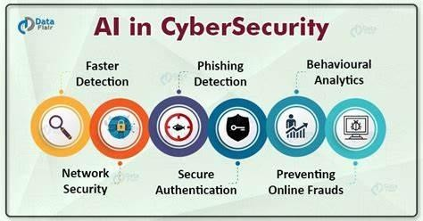
IMPLEMENTATION OF AI IN CYBER SECURITY:
Determine your security needs
Identify potential threats
Choose the right AI technology:
Collect and process data
Train your AI system

Slide 16
CONCLUSION
Artificial intelligence is quickly arising as a high priority innovation for improving the performance of IT security groups. AI gives the genuinely necessary analysis and threat identification proof that can be utilized by security experts to limit breach risk and upgrade security posture. AI can help to discover and focus on risks, direct incident response, and distinguish malware attacks before they come into the scenario. Thus even with the expected drawbacks, AI will effectively drive cyber security forward and it will assist the organization in practicing a more powerful security posture.

Slide 17
THANK YOU

